Slide 1
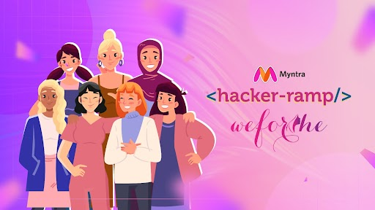
Team Name : POWER-PAIR
Team Details: Sulakhshana Pandita
Yashaswini Kulshrestha

Slide 2



PROBLEM STATEMENT
TREND GENERATION
Fashion-savvy individuals often struggle to visualize how trendy items will look on them without physically trying them on, leading to hesitation and reduced confidence in online purchasing decisions. Additionally, there is lack of personalized fashion advice that aligns with the latest trends. Therefore, how can we leverage AI to provide an interactive and personalized shopping experience, generate trend recommendations specifically for the Gen Z , and receive real-time, tailored fashion advice?
SOCIAL SHOPPING INTEGRATION
The Gen-Z audience seeking to stand out and stay updated with the latest trends often struggle to find platforms that offer a seamless & engaging shopping experience. How can we integrate social media functionalities and user-generated content, to create an interactive and immersive shopping experience that resonates with fast fashion enthusiasts, while also ensuring eco-friendly, sustainable clothing options ?

Slide 3


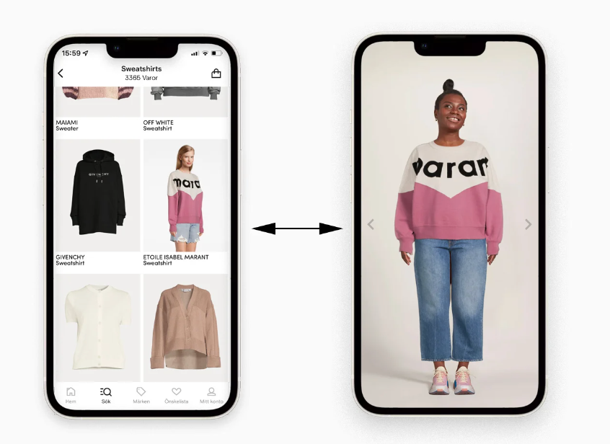
SOLUTION :
#TRYONTREND
"VIRTUALLY TRY ON THE HOTTEST
Gen - Z Styles Now!"
Dive into the latest trends with cutting-edge virtual try-on feature.
Instantly see how the newest Gen Z fashions, fit and flatter your style, all from the comfort of your screen.
Try it, love it, and make it yours without ever leaving home!"
BENEFITS :
Crucial role in trend generation by leveraging data-driven insights, personalized recommendations, and interactive experiences.
Will empower Myntra to proactively introduce trend-setting collections that resonate with evolving fashion preferences.
Reduce Return Rates.
Will enhance Customer Confidence &
strengthen Brand reputation.

Slide 4
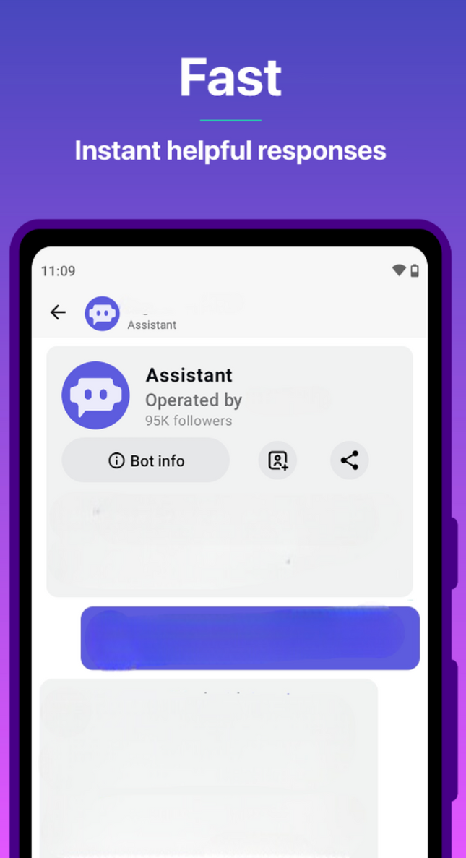


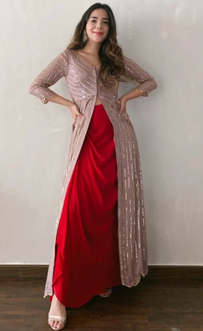
SOLUTION :
"MEET YOUR NEW STYLE GURU: AI CHATBOTS!"
Get instant fashion advice and trend-savvy tips to rock the latest Gen Z looks effortlessly. Style made simple, right at your fingertips!"
Will provide personalized one-on-one styling advice like a human stylist.
The bot will ask about the occasion, body type, and skin tone to suggest outfits. allow customers to upload wardrobe images or social media pics for recommendations or to find similar products.
BENEFITS :
Hey Sarah! What kind of an outfit are you looking for?
Will enhance customer satisfaction by offering round-the-clock styling advice and personalized outfit recommendations.
Provide guidance throughout the purchasing process.
AI chatbots can gather valuable insights from customer interactions, such as popular product preferences and emerging trends, which can inform inventory decisions and marketing strategies.
These can efficiently handle increasing volumes of inquiries and transactions, reducing operational costs associated with customer support.
"Diwali is coming, and I want to buy something ethnic that also has a trendy look. Any recommendations?"
"Certainly! Take a look at these latest ethnic pieces that combine traditional elegance with a trendy look. I'm sure you'll find something perfect for Diwali!"

Slide 5
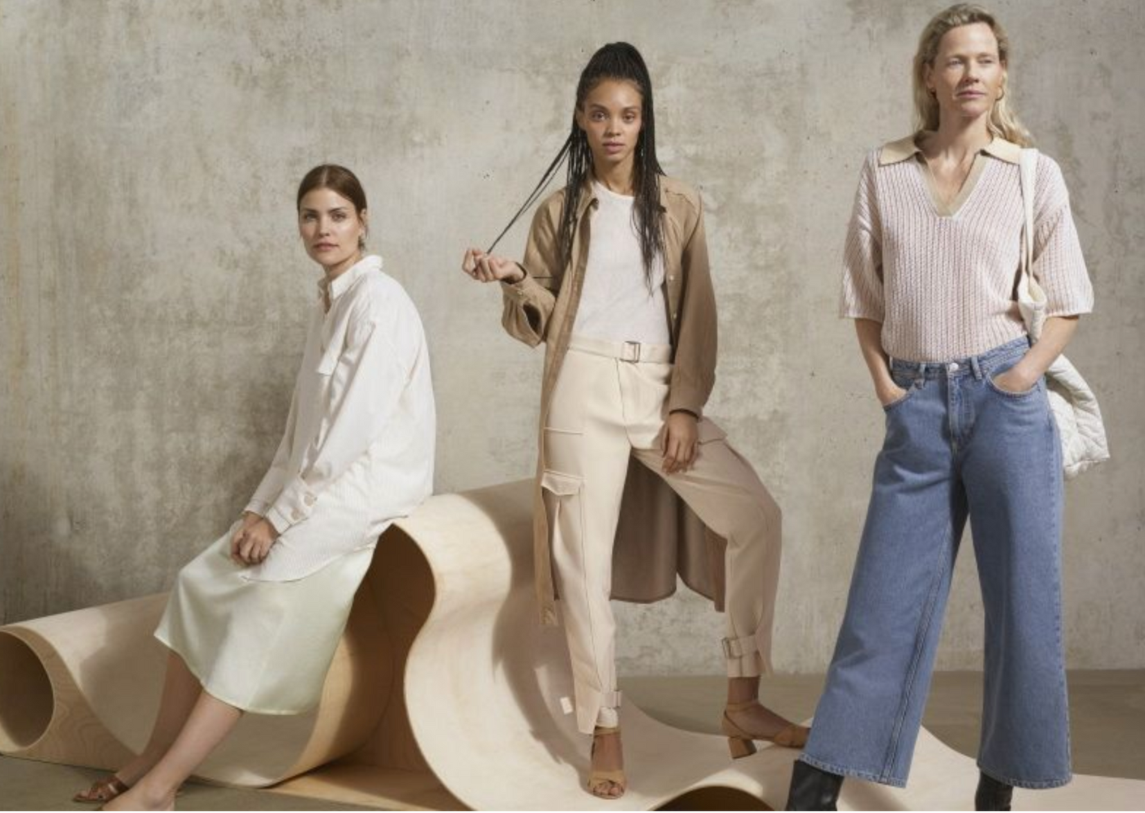
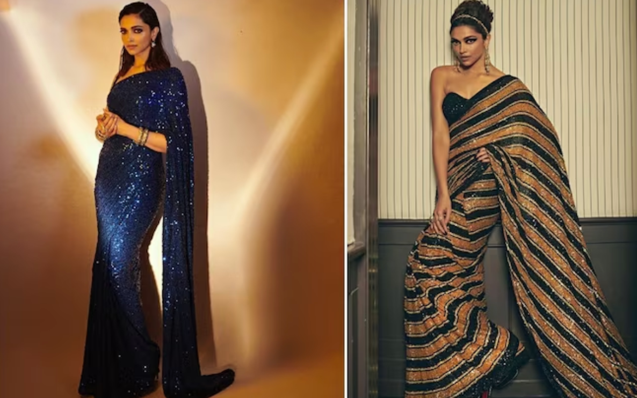

SOLUTION :
ECO-CHIC
CAPSULE COLLECTION
INFLUENCER-REPLICAS
"Step into the spotlight with Myntra's Influencer Replica Collection!
Embrace Gen Z style icons with replicas of influencer and TV star outfits, which would be available exclusively as limited edition drops on our site.
From casual chic to red carpet glam, each piece will set the trend for the ultimate fashion-forward statement."
Elevate Your Style Sustainably! Discover timeless pieces crafted with care for a wardrobe that's as conscious as it is chic.
Each product will include its carbon footprint, empowering Gen Z shoppers to make sustainable choices.
BENEFITS :
BENEFITS :
Will position Myntra as a leader in eco-friendly retail, attracting environmentally conscious consumers.
Will Educate and Empower Consumers.
Will contribute to Global Goals as well.
Drive Sales and Traffic.
Enhance Brand Visibility.
Creating Exclusive Collections or limited-edition pieces can create buzz and excitement, driving customer engagement.

Slide 6
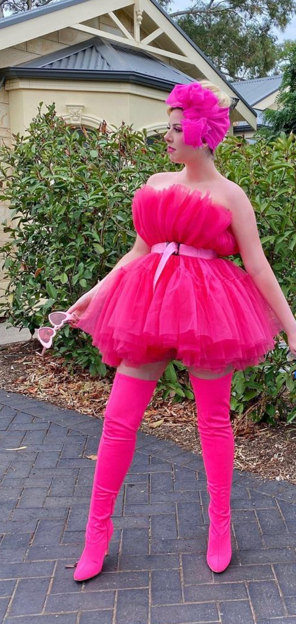
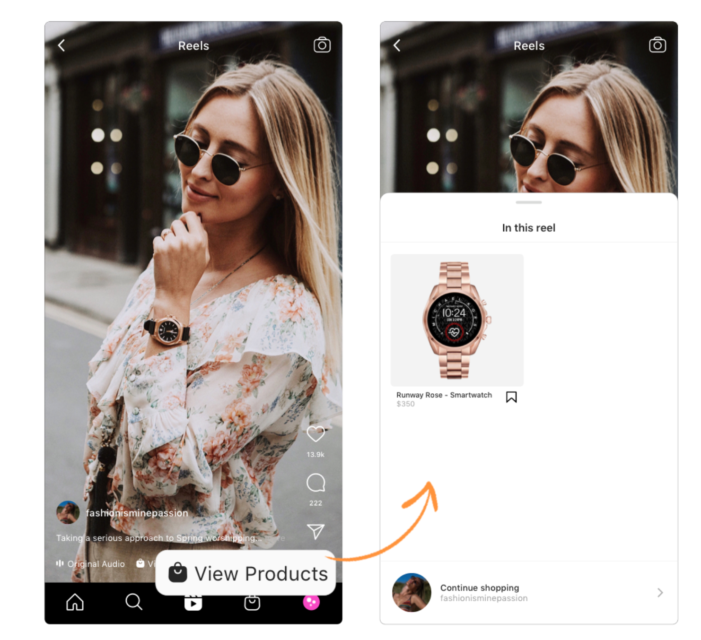
SOLUTION :
SHOPPABLE
STORIES & REELS
STYLE
CHALLENGES
CREATE , SHARE & WIN!
Showcase your fashion flair with Myntra’s Social Style Challenges!
Create stunning outfits or show off your own creations, share them on social media with our hashtag, and win amazing prizes.
Winners get exclusive discounts, gift cards, and can get featured on Myntra’s pages.
Experience seamless shopping with Myntra's Stories & Reels.
Explore captivating videos showcasing the hottest styles & latest trends among gen-z.
Shop the looks with direct links to purchase featured items effortlessly.
BENEFITS :
BENEFITS :
Will enhance Engagement and Reach.
Adapting to Digital Trends will capture the attention and loyalty of Gen Z customers who value digital and social engagement.
Will allow the gen-Z to showcase their personal style and creativity, creating a deeper emotional connection with the brand.
Will enhance Product Discovery.
Will engage Gen-z users with trendy fashion content..
Real-time promotion will keep customers informed about the latest styles and encourage immediate purchases, driving sales and maintaining interest.

